Slide 1
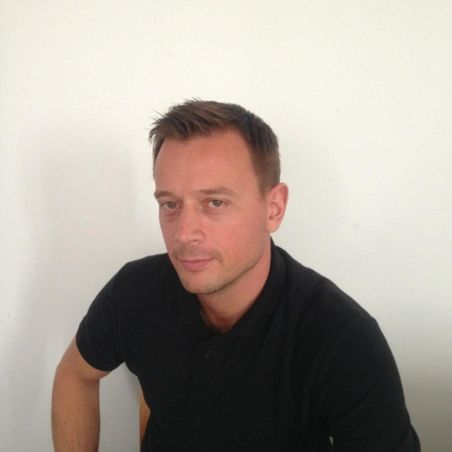
Manufacturing Consultant Christian Foyer
Languages
Lean Specialisation
Lean Track Record
Lean Track Record
English
German
French (basics)
Christian has learned his lean skills at Mercedes’ Lean Expert group during a 1 year intensive training program. Internal lean experts at Daimler are operating worldwide dedicated to coordinate the large scale transformation programs throughout Daimler’s manufacturing plants.
His extensive experience in applying lean in various different environments created a deep understanding of principles which makes him an excellent trainer and coach.
Having sat on both ends of the table Christian knows the importance of delivering bottom line results. Therefore every one of his projects starts and ends with a rigorous focus on delivering these targets.
Being passionate about effective and sustainable change Christian knows how to lead big teams and how to deliver effective knowledge transfer and a well structured complementary improvement program.
Christian’s academic back-ground helps him to see through very complex situations so that he almost always finds the next step and approach to get to a positive solution.
An additional strength of Christian is his rigorous focus on establishing robust processes. For him ‘A good Process will deliver good results’!
Lead company turn-around project for UK based automotive component supplier (casting foundry, machining plant and assembly operations) through a lean structure roll-out including organisational arrangements in value stream structure, policy deployment strategy, roll out of Total Quality Management tools, restructuring of plants, facilities and layouts. Deliverables: Client was taken of red supplier lists of key automotive customers, operations result improved from ~ £ 600 000 monthly loss to a break even position in 1.5 years.
Restructuring of a mobile phone repair centre operation in the midlands. The project included a lean principle roll-out to not only to stream line the repair operations but also improve customer experience by improving fault finding during the customer call to reduce repair volumes coming in. Deliverables: Return volumes had been reduced by ~15% and productivity of the repair centre operation increased by 20 %. Operational savings > 6 m £ per year.
Delivery of various lean improvement programs within Mercedes-Benz Europe including quality improvements at the Smart car plant in France, productivity improvements of a casting foundry and various improvement projects at high volume assembly lines across Mercedes’ Powertrain organisation.
Roll-out of Mercedes-Benz Production System Racing at Mercedes’ Formula 1 Engine Manufacturing Plant in Brixworth UK. This roll-out focussed on the main lean principles to primarily achieve reduced manufacturing leadtimes and improved quality.
Deliverables: Engine failure rate in races improved
from10 per season to 0. For some parts the
manufacturing leadtimes had been reduced by over
80% (e.g. cylinder heads and crankshaft lines).
Hobbies
Karting
Golf
Windsurfing
Professional Experience
Since 2009 Managing Director at RiverRouge Consulting Ltd UK
2 years ‘Interim’ Plant Manager at Mahle Powertrain UK (through RiverRouge Consulting )
2 years ‘Interim’ Head of Powertrain Operations at Lotus Cars (through RiverRouge Consulting
2 years Lean Manufacturing Consultant at Vodafone UK (through RiverRouge Consulting )
3 years Lean Manufacturing Expert at Mercedes-Benz Germany (European powertrain plants)
2 years Lean Manager at Mercedes-Benz High Performance Engines UK
2 years Manufacturing Engineer at McLaren
Certifications / Degrees
Coded Welder Certification
IAFT 16949 and VDA 6.3 Lead Auditor
‘Lean Manufacturing Consultant’ Certification
Lean Six Sigma Black Belt Certification
Lean Awareness Training
Leading Safely (Director Level)
Masters Mechanical Engineering (University Stuttgart)
Bachelor Degree in Economics (University Hohenheim)
IT Skills
Daily Rate
MS Office
Minitab
CNC-Programming
Xero
www.riverrougeconsulting.co.uk

